Slide 1

DriverPass System Analysis
[Andrew Bolton]
Notes:
[No speaker notes required for this slide.]

Slide 2

System Requirements
We want the system to offer different packages and for the provider to change up these packages and make specials.
The system needs to be able to handle making,modifying and Canceling Appointments that were made.
The system will all be web based to allow for easier use and access to all their testing and learning materials Via website.
The system will be light enough for easy access and speed with any kind of connection to the website.
Notes:
So in the system requirements I made a few bullet points to outline the big things that we are making system requirements such as For you to be able to change up packages and make specials around the holiday. Another Big point that I want to throw out there is that the system is going to be able to handle you booking or modifying or canceling any appointments that were made and that is including the roadside test and practice because you never know when someone might get sick we're not able to make it due to personal reasons. Sense for reaching to a large audience we also want to make the site easy enough to navigate but not super fancy that it can lead to problems with people having lower connection speed so that way we cover a bigger customer base. With the system being web based in lightweight they will be able to access with greater speed testing and learning materials via the site without any complications.

Slide 3
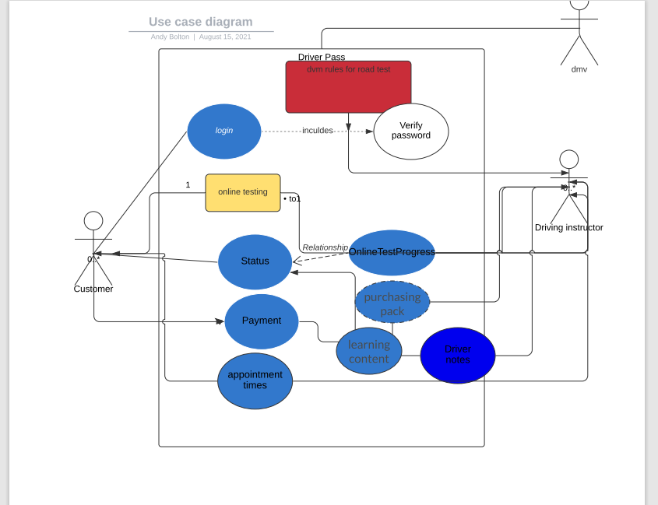
Use Case Diagram
Notes:
When I designed I accounted for the DMV being Involved because they are going to be the ones to give us the set of rules that we need to follow and that the driving instructors will need to make for the test. When I was thinking about the Program that would be used so I outlined the very basic means of the driver pass. Some of the things that are there are like login you'll need a place to store the rules from the DMV that we get and then we also need to have somewhere to track payments to know whether a student has paid or if their payment is still pending because we don't want to be giving out something for free at this point along with a type of area of the place the payment packages you know maybe we have a 50% off package going on. We also need a place to track the online testing all need information stored

Slide 4
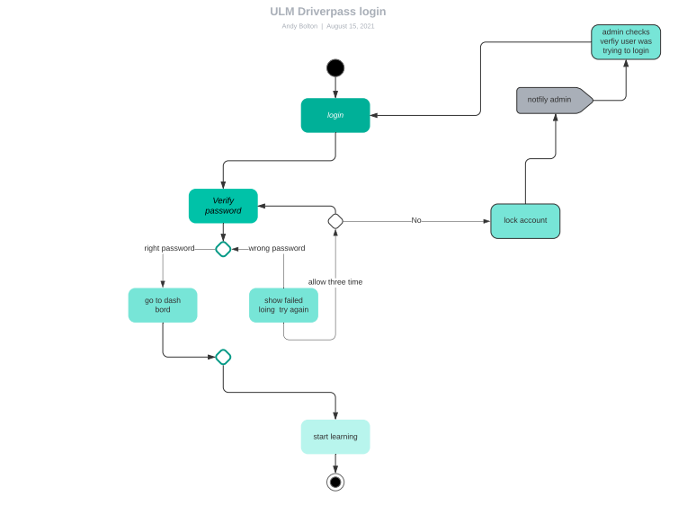
Activity Diagram
Notes:
I wanted to breakdown in detail the login process and some of the security measures I took to be able to help prevent people from using someone elses account. I broke down each step into individual things that much happen in order to trigger the next step for instance verify password if it doesn't match then it gets thrown off to another part that will allow my attempt again up to three times after that it will lock the account and notify the admin that someone was trying to access without authorization to that account. Which in turn they will send out a notification to that user asking whether they were trying to access the account or not if they say yes then the password will be reset. I was thinking about how driver pass would need something secure but also we don't want to overcomplicate it because we don't want the user or for the business to get frustrated with people constantly getting locked out because let's face it we all make mistakes sometimes we fat finger or something. So I detailed the login process to be able to help everyone understand how we proceed with an instance of someone getting locked out of the account.

Slide 5
Security
I thought about the cloud /server that would be responsible for exchanging the data and what type of security setup should be provided for that.
We are definitely going to need to require a username and password in order to log in to the server/cloud
They will be set up on multiple-factor authentication for the login site that will require two forms of identification besides the username and password especially for the admin login.
There will be a rule set up that will account for if the user logged in three times incorrectly Will be locked out. By doing this will help prevent brute force attacks
We will need to track any changes that are made to make sure they are done by the right people.
Notes:
When I was thinking of security I had to put myself on the dark side of how would I attempt to get in and cause damage to the system. By doing this helped me think of some key ideas to keep people out and put in safeguards to prevent something bad from happening along with someone causing mischief with someone elses account also to not allow that account to get stolen along with their personal information. Because if their personal information got stolen that would be very bad for business. So I outline in the bullet points five things that are key to keeping this business thriving and secure from any type of attack .

Slide 6
System Limitations
No budget defined by business
Only five months to build something from ideas to finished working product Forces us to condense the agile process.
Downloading information to your personal computer to track the progress of students.
Notes:
I have found some very big problems with some system limitations here and they are not necessarily on the technical side for one there's no budget defined by the business which means they could say at anytime that we've exceeded it and halt the project or have us put out what we currently have done which could lead to crashes and things getting stolen or flat out not working. The second one is we only have five months to build something from an idea to a finished working product which forces us to condense the agile process which is not meant to happen everything takes time and there may be bugs bumps or additional information that we need to get or even permits and security clearance they handle some types of information which takes time to do. Lastly is downloading the information to your personal computer to track the progress of students and or driving instructors. This alone invites a big problem due to some of this information may not be sensitive and the business owner has not defined what time of information this would be because there are some things that actually need extra security depending on what it is like a credit card number or their home address would require an extra permit and you can't just download it as a file it would need to have extra security and that person's computer would need to have a VPN connection to download it into a secure side of their hard drive blocked off from the rest which takes more than five months to do on top of everything else they want to have done.

